Slide 1



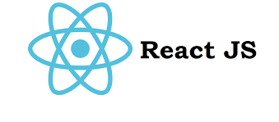
Hi there!
I’m Adrian Sudbury
I’m currently working on
AWS
Node.js
Pulumi
React

